Slide 1

November 2021
Audit Data Science
Use Case
Audit and Assurance

Slide 2
Audit Data Science Use Case
Using ML to Solve Problems

Slide 3
Audit Use Case Ideation
Solving real world problems by applying Machine Learning
Leverage your new ML skills to identify Audit Use Cases
Apply your favorite ML techniques
Participants will complete the use case slide 5 and this will help structure your idea
Example attached
Record a brief video (2 minutes) explaining your idea and business impact
Submission due by November 26, 2021:
Audit Use Case (slide 5)
2-minute video
Send presentation to:
David Wu (dawu@deloitte.com)

Slide 4
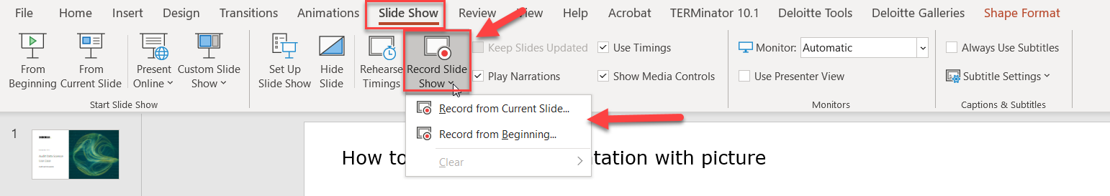

How to record your presentation with audio and picture in picture
Instructions and tutorial link:
Record a slide show with narration and slide timings (microsoft.com)

Slide 5
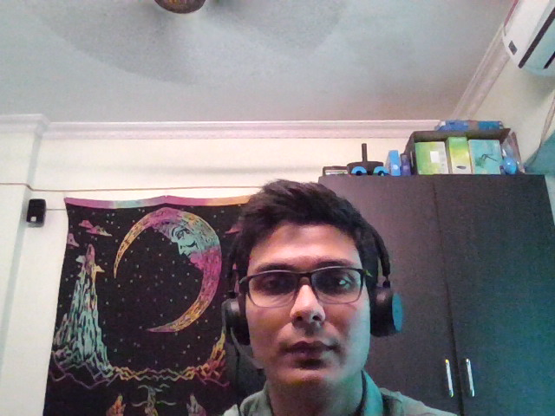
Audit Data Science Use Case: <Instrument Sampling for Independent Fair Valuation>
PROBLEM: Describe a business or client problem
Sampling of Financial instruments by the Audit engagement teams such as derivatives, structured products and other complex instruments for Independent fair valuation performed by NSPC (National Securities Pricing Center) practitioners.
SOLUTION: What kinds of machine learning algorithms and solutions can be applied to solve the client problem?
Use Clustering Algorithms like DBSCAN/HDBSCAN to identify outlier selections from the client portfolios based on Materiality, complexity and market data inputs characterized by features namely, Total Number of Inputs required and Number of Market Observable Inputs. These selections can be added to the samples for Independent fair valuation by the pricing team.
KEY METRICS: How would you measure your algorithm’s success?
Identify the outlier selections based on cluster labels.
ML evaluation :
Use Silhouette Coefficient to determine the hyperparameters to achieve a cluster model with optimum number of density clusters.
UNIQUE VALUE: Simple, clear, compelling message that states why you and your ML algorithm are worth paying attention to.
Deploy a focused and automated solution to identify complex and illiquid instruments in the client portfolio for independent valuation.
Aid from the NSPC specialist team for feature engineering to form quality clusters.
CHANNELS: How can you deliver this ML algorithm to the customer (e.g. embedded app feature, in-database, etc.)?
We can deliver the solution using the DNAV/Delphi Valuation Portal.
The end user will interact directly with the DNAV/Delphi Valuation Portal to further review the samples created from the outliers.
CUSTOMER SEGMENTS: Who will be directly impacted by your ML algorithm solution?
Audit engagement teams. Current sampling methods are more descriptive in nature and mostly based on materiality except for specific clients.
ML can accelerate the process to identify complex and illiquid instruments/selections and carry out Independent Fair Valuation smoothly.
OTHER: What do you need to make this happen (e.g., people, process, technology, data)?
Data: Client data with portfolio of Instruments/Selections.
DNAV/Delphi Portal Architecture: To extended the line of service provided by the NSPC team.

Slide 6
Audit Data Science Use Case: Journal Entry Anomaly Detection
PROBLEM: Describe a business or client problem
Identifying infrequently occurring transactions that possess a “uniqueness” within its observed features relative to its resident transaction population that are indicative of significant unusual transactions (SUTs) or fraudulent transactions.
SOLUTION: What kinds of machine learning algorithms and solutions can be applied to solve the client problem?
Using clustering models as the primary means of identifying “uniqueness”. Clustering Algorithms like DBSCAN/HDBSCAN, k-means, self-organizing maps
KEY METRICS: How would you measure your algorithm’s success?
Quality of the outliers identified based on subject matter review
ML evaluation :
Elbow method to examine the percentage of variance explained and determine # of clusters
VALUE: Simple, clear, compelling message that states why you and your ML algorithm are worth paying attention to.
Enable a targeted, focused, and automated solution to identify anomalies and high-risk transactions.
Increased efficiency and minimal waste explaining/refuting false positives
CHANNELS: How can you deliver this ML algorithm to the customer (e.g. embedded app feature, in-database, etc.)?
We can deliver the solution using a web application.
The JE data will be preprocessed and stored in a database.
The end user will interact directly with the website to review anomalies and outliers
CUSTOMER SEGMENTS: Who will be directly impacted by your ML algorithm solution?
Audit engagement teams. Current JE analysis are more descriptive in nature with predefined rule sets.
ML can accelerate the speed to identify outliers and find patterns that are not obvious to manual review.
OTHER: What do you need to make this happen (e.g., people, process, technology, data)?
Data: Journal Entry data and Financial Statement account mapping details on the Trial balance level
Cloud: To host the web application
Frontend: Flask or react front end for user UI experience

